Slide 1
Week 6 Presentation
Team 16
By: James Panhorst, Jibin Mathews, Josh Ramirez, Alex Holmes

Slide 2
Objectives
Develop an autonomous robot that can navigate racetrack and avoid obstacles
Must be able to:
Follow Metallic Tape (IPS: LJ18A3-8-Z/BX)
Avoid Obstacles (IR Sensor: GP2Y0A60SZ0F)
Detect/ proceed actions with corresponding colors (Color Light-to-Frequency TCS3200)
Green: Go
Blue: Slow Down
Red: Stop

Slide 3
Deliverables For Week 6
Implemented 2 Amp Fuse into the circuit
Obtained three sensors that will be needed for main project
Began to research each new sensor
Tested wire connections for the IPS and IR sensor using a multimeter
Tested TCS3200 Color sensor with Arduino and code

Slide 4
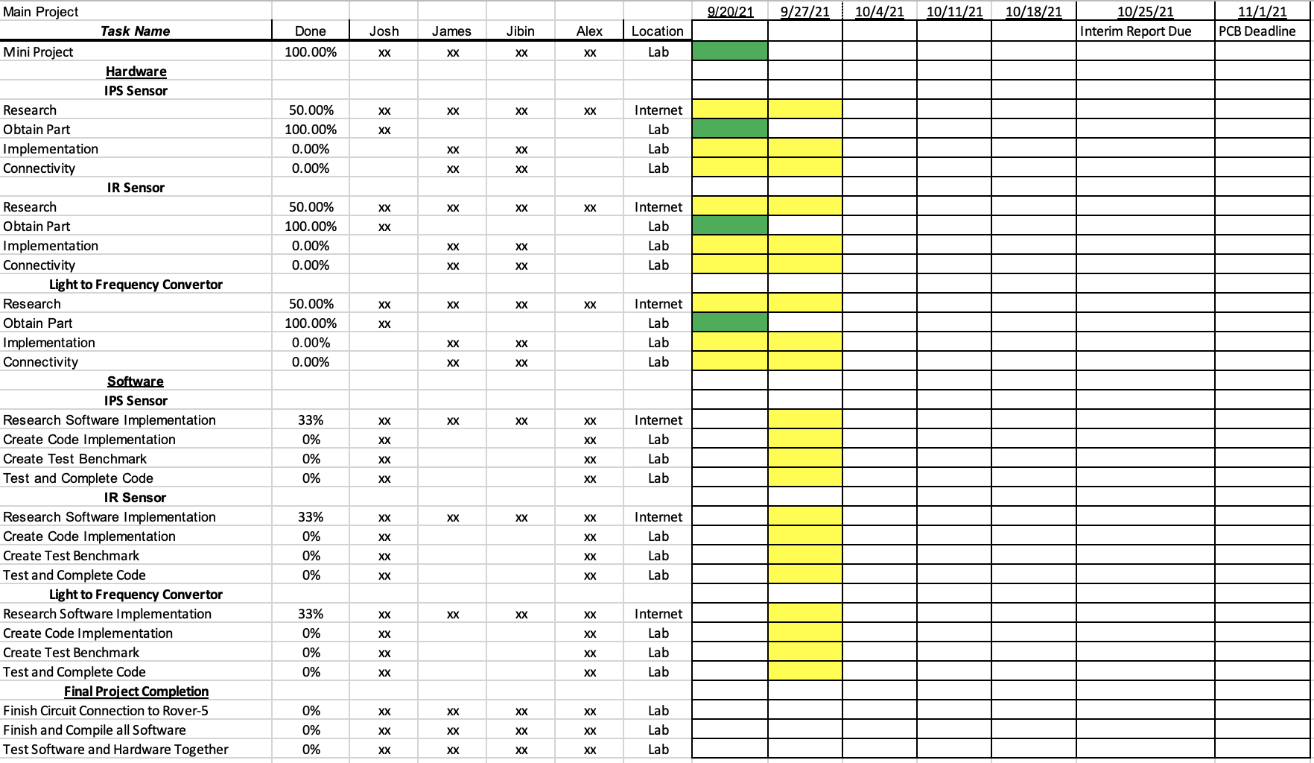
Gantt Chart

Slide 5
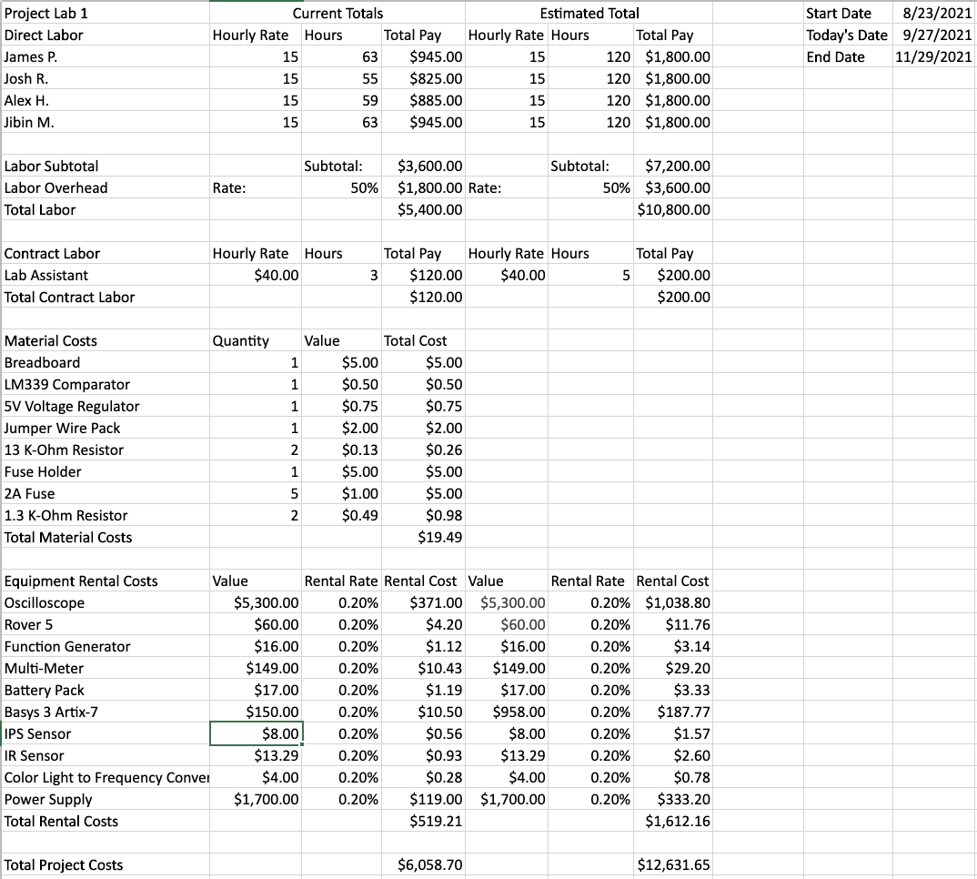
Budget Sheet

Slide 6
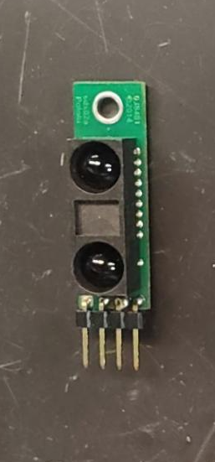
IR Sensor (GP2Y0A60SZ0F) [1]
Utilizes an IR-LED emitter and a PSD (position sensitive detector) to output a voltage corresponding to the detection distance.
Has a distance measuring range of 10-150 cm.
Accepts a supply voltage of up to 5.5 V (DC) through its Vcc pin.
Displays a low voltage of less than 1.0 V until an object is detected in front of it, where it then increases voltage out to near the supplied input voltage at Vcc.

Slide 7
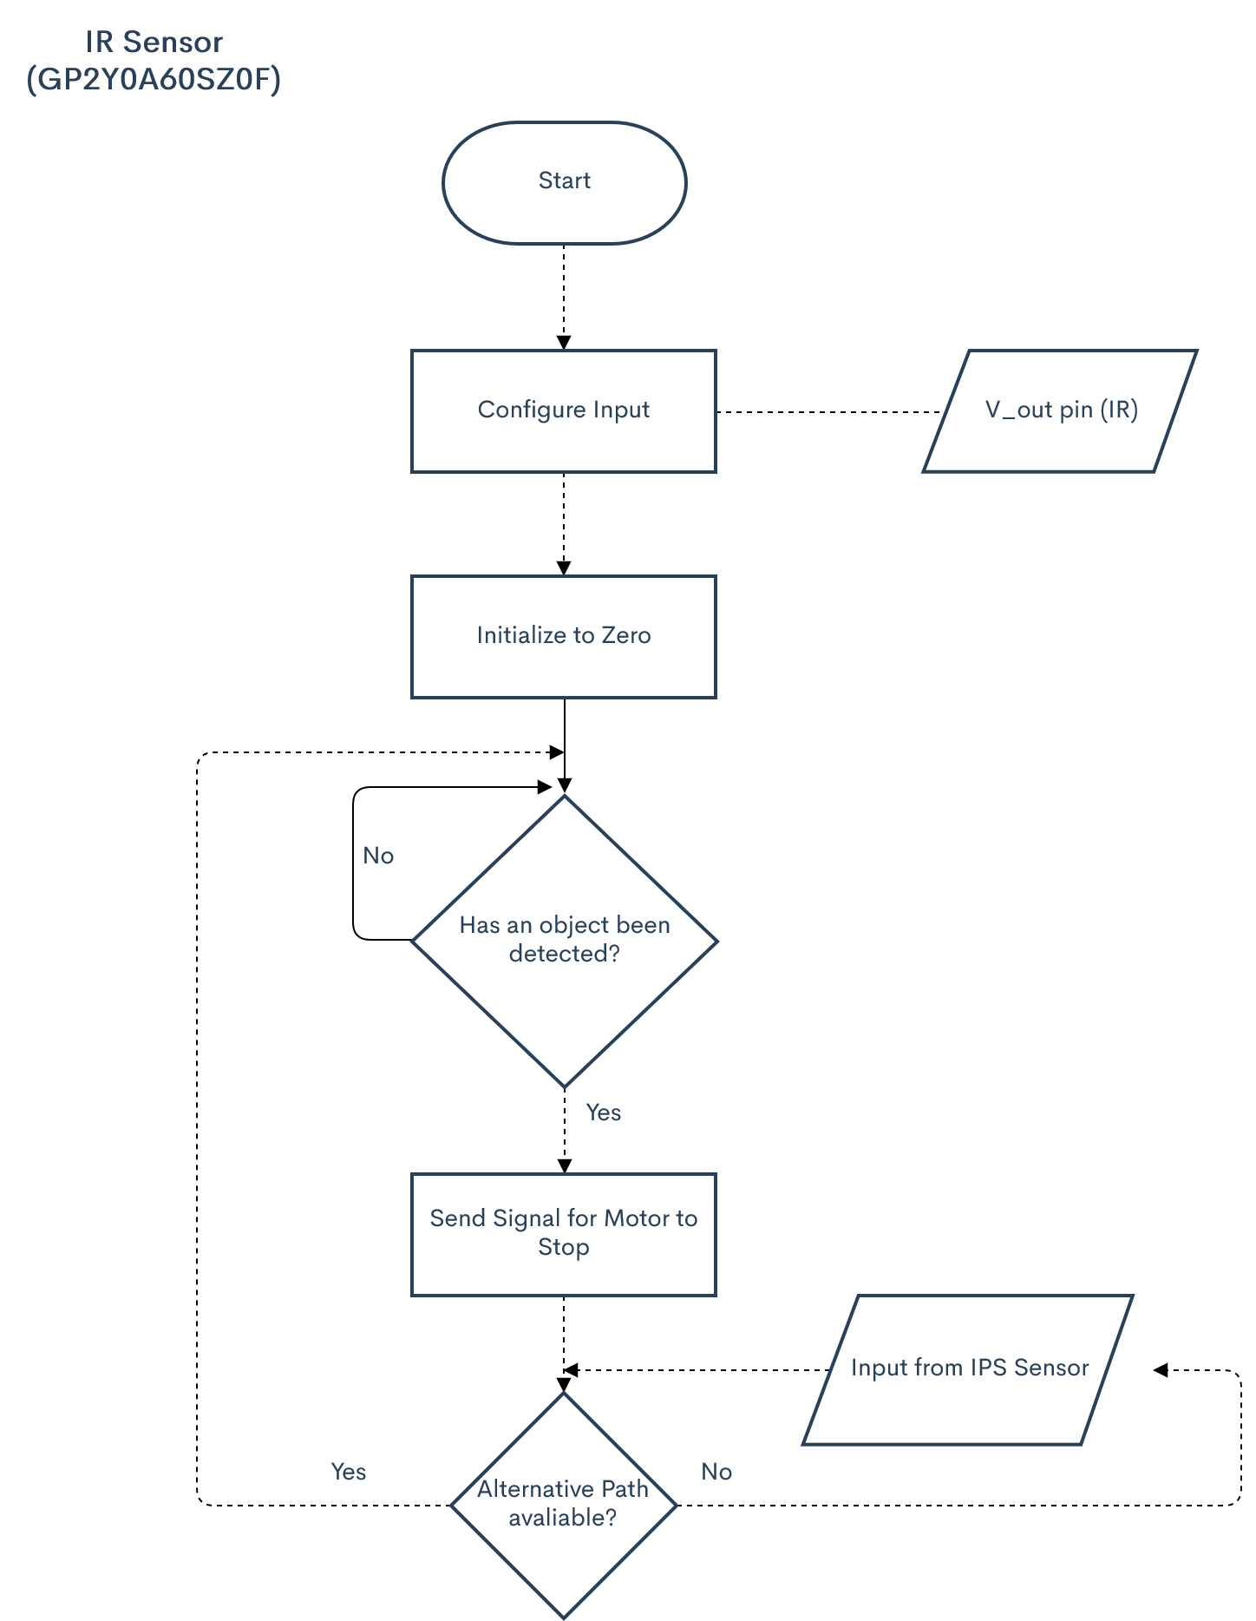
IR Sensor: Logic

Slide 8
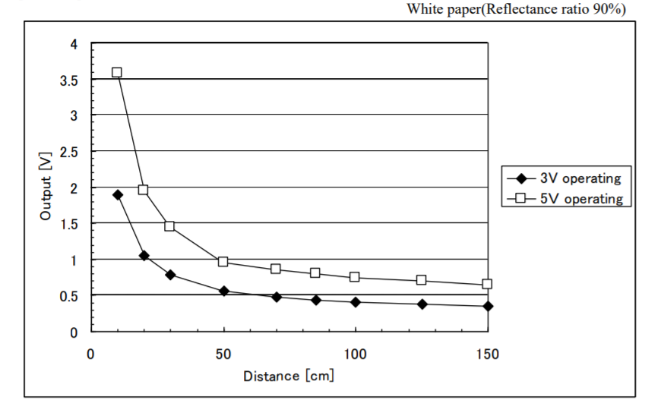
IR Sensor: Output Voltage (V) vs Distance (cm)
This graph displays the sensor's output voltage corresponding to distance (cm) for both 5V and 3V power sources.
[1]

Slide 9
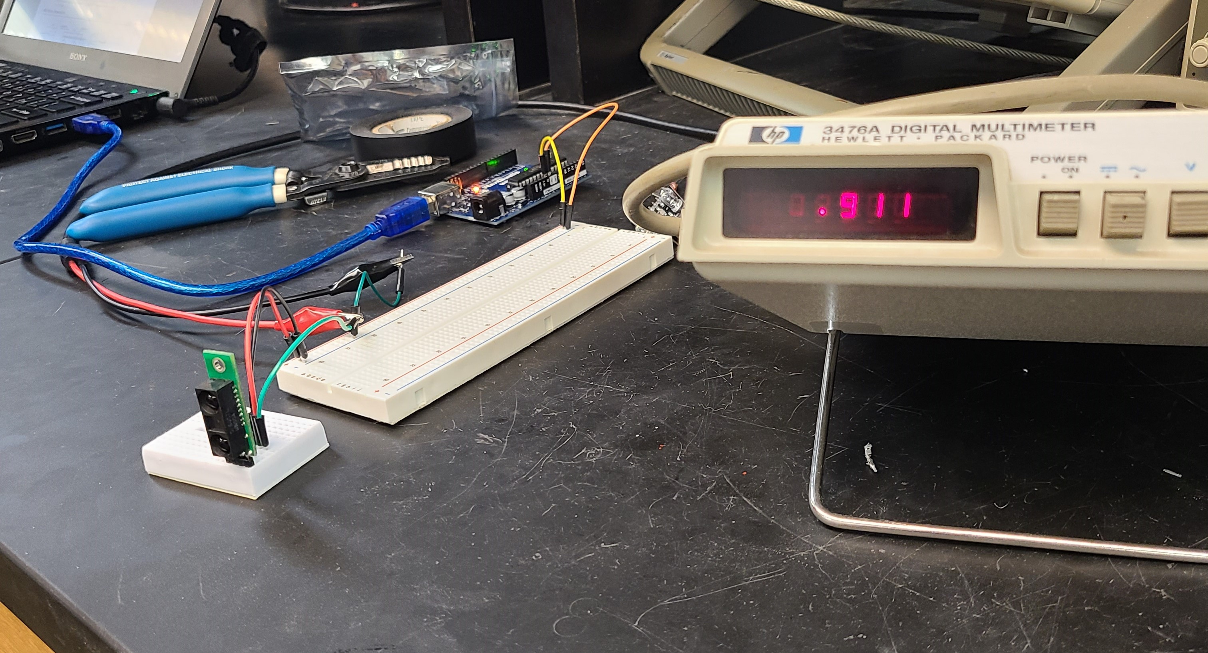
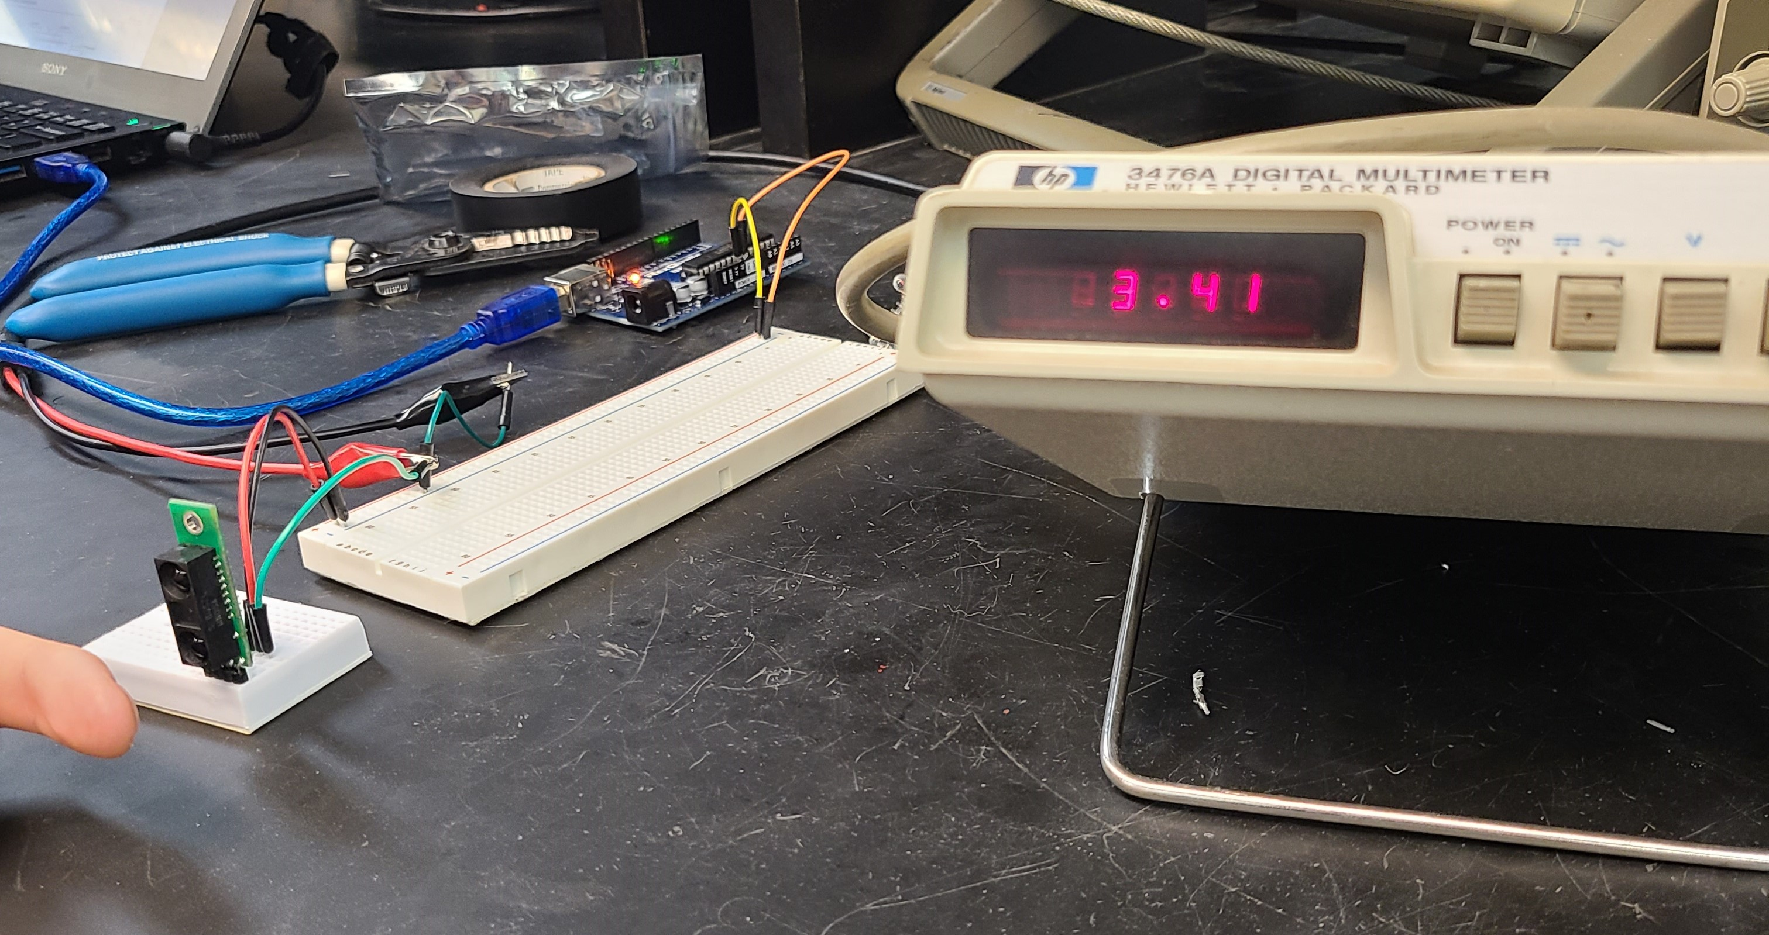
IR Sensor: Experimental Testing (5 V input)
While no object is detected, the voltage remains under 1.0 V.
When an object is detected, the voltage increases to roughly 3.5 V.

Slide 10
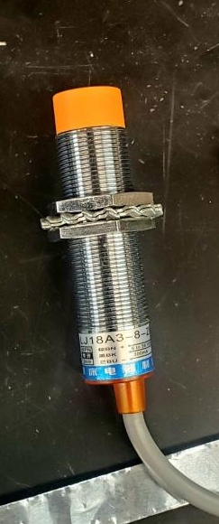
IPS Sensor (LJ18A3-8-Z/BX)
Used to detect metal or metallic objects up to 8mm
Accepts a voltage from 6 V to 36 V
LED turns on when metal or metallic object is detected

Slide 11
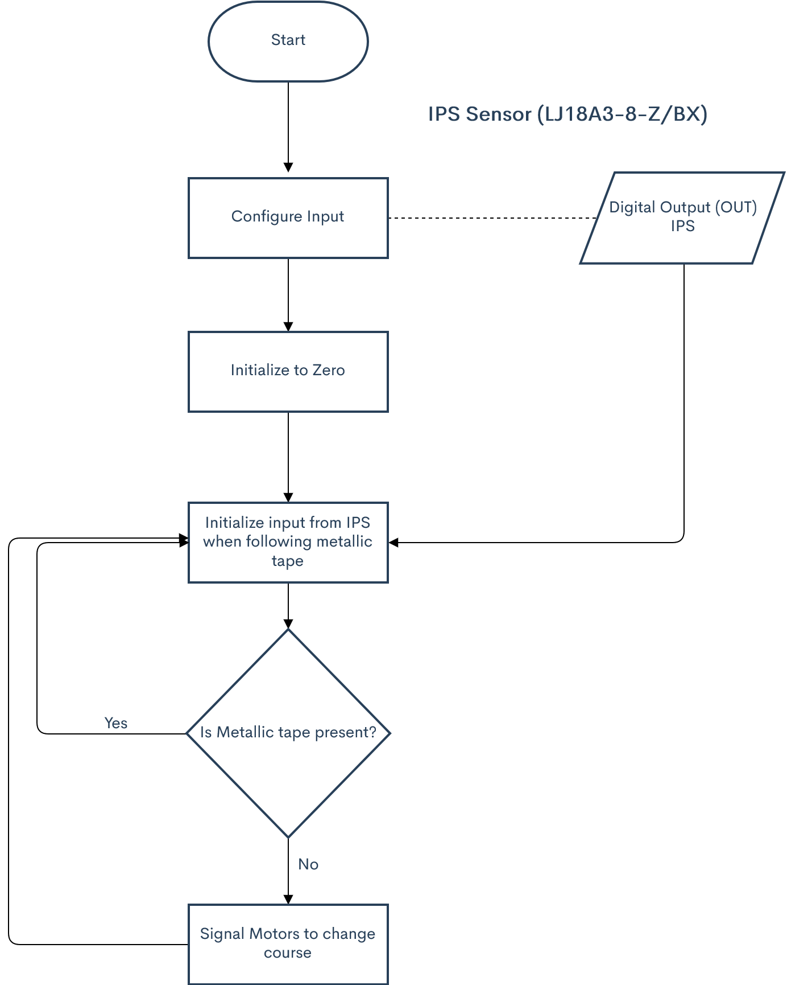
IPS Sensor: Logic

Slide 12
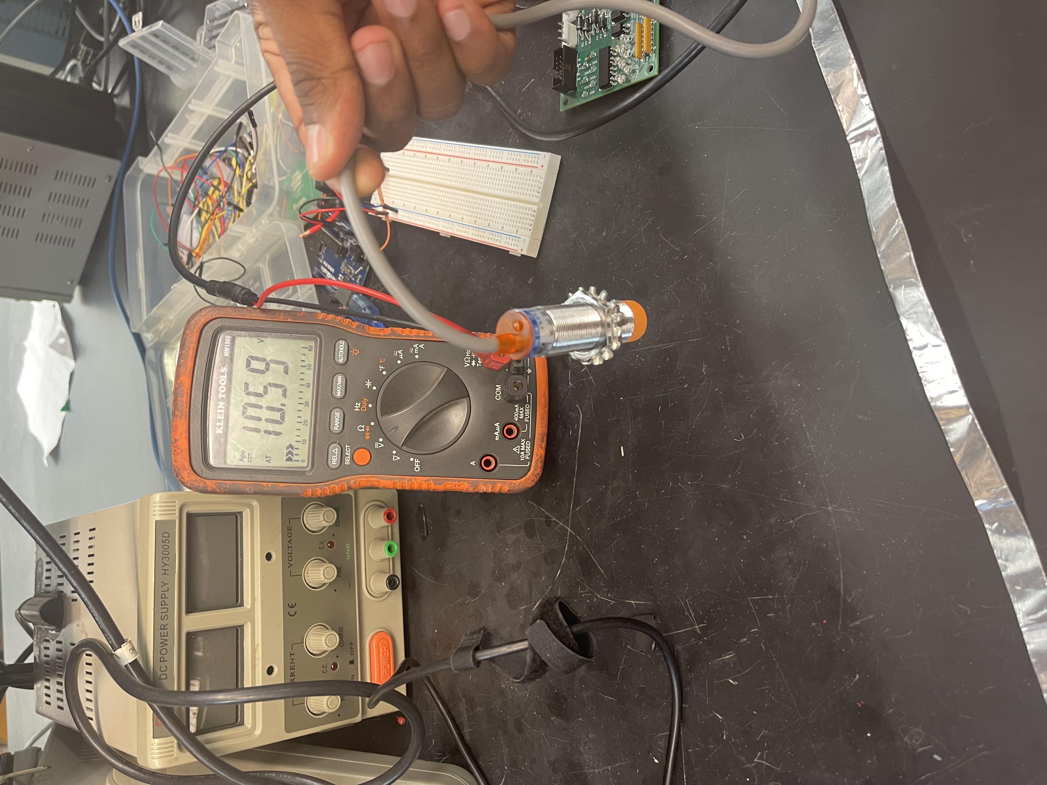
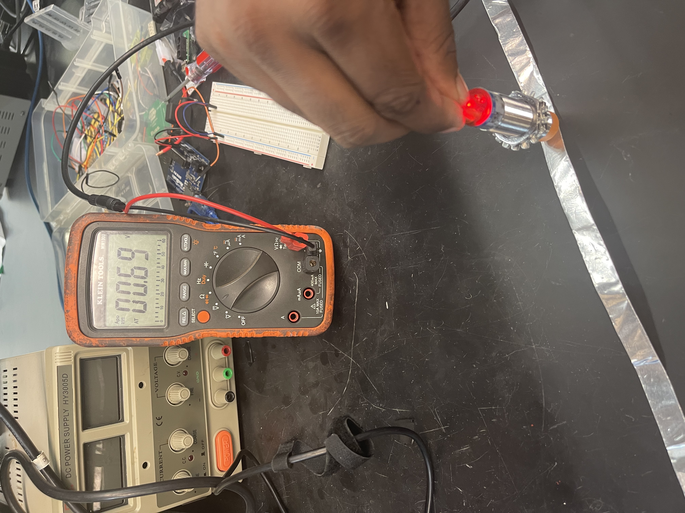
IPS Sensor: Test Results

Slide 13
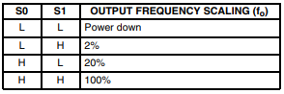
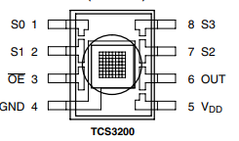
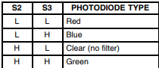
TCS3200 Color Light-Frequency
Mouser.com/catalog/specsheets/tcs3200-e11.pdf

Slide 14
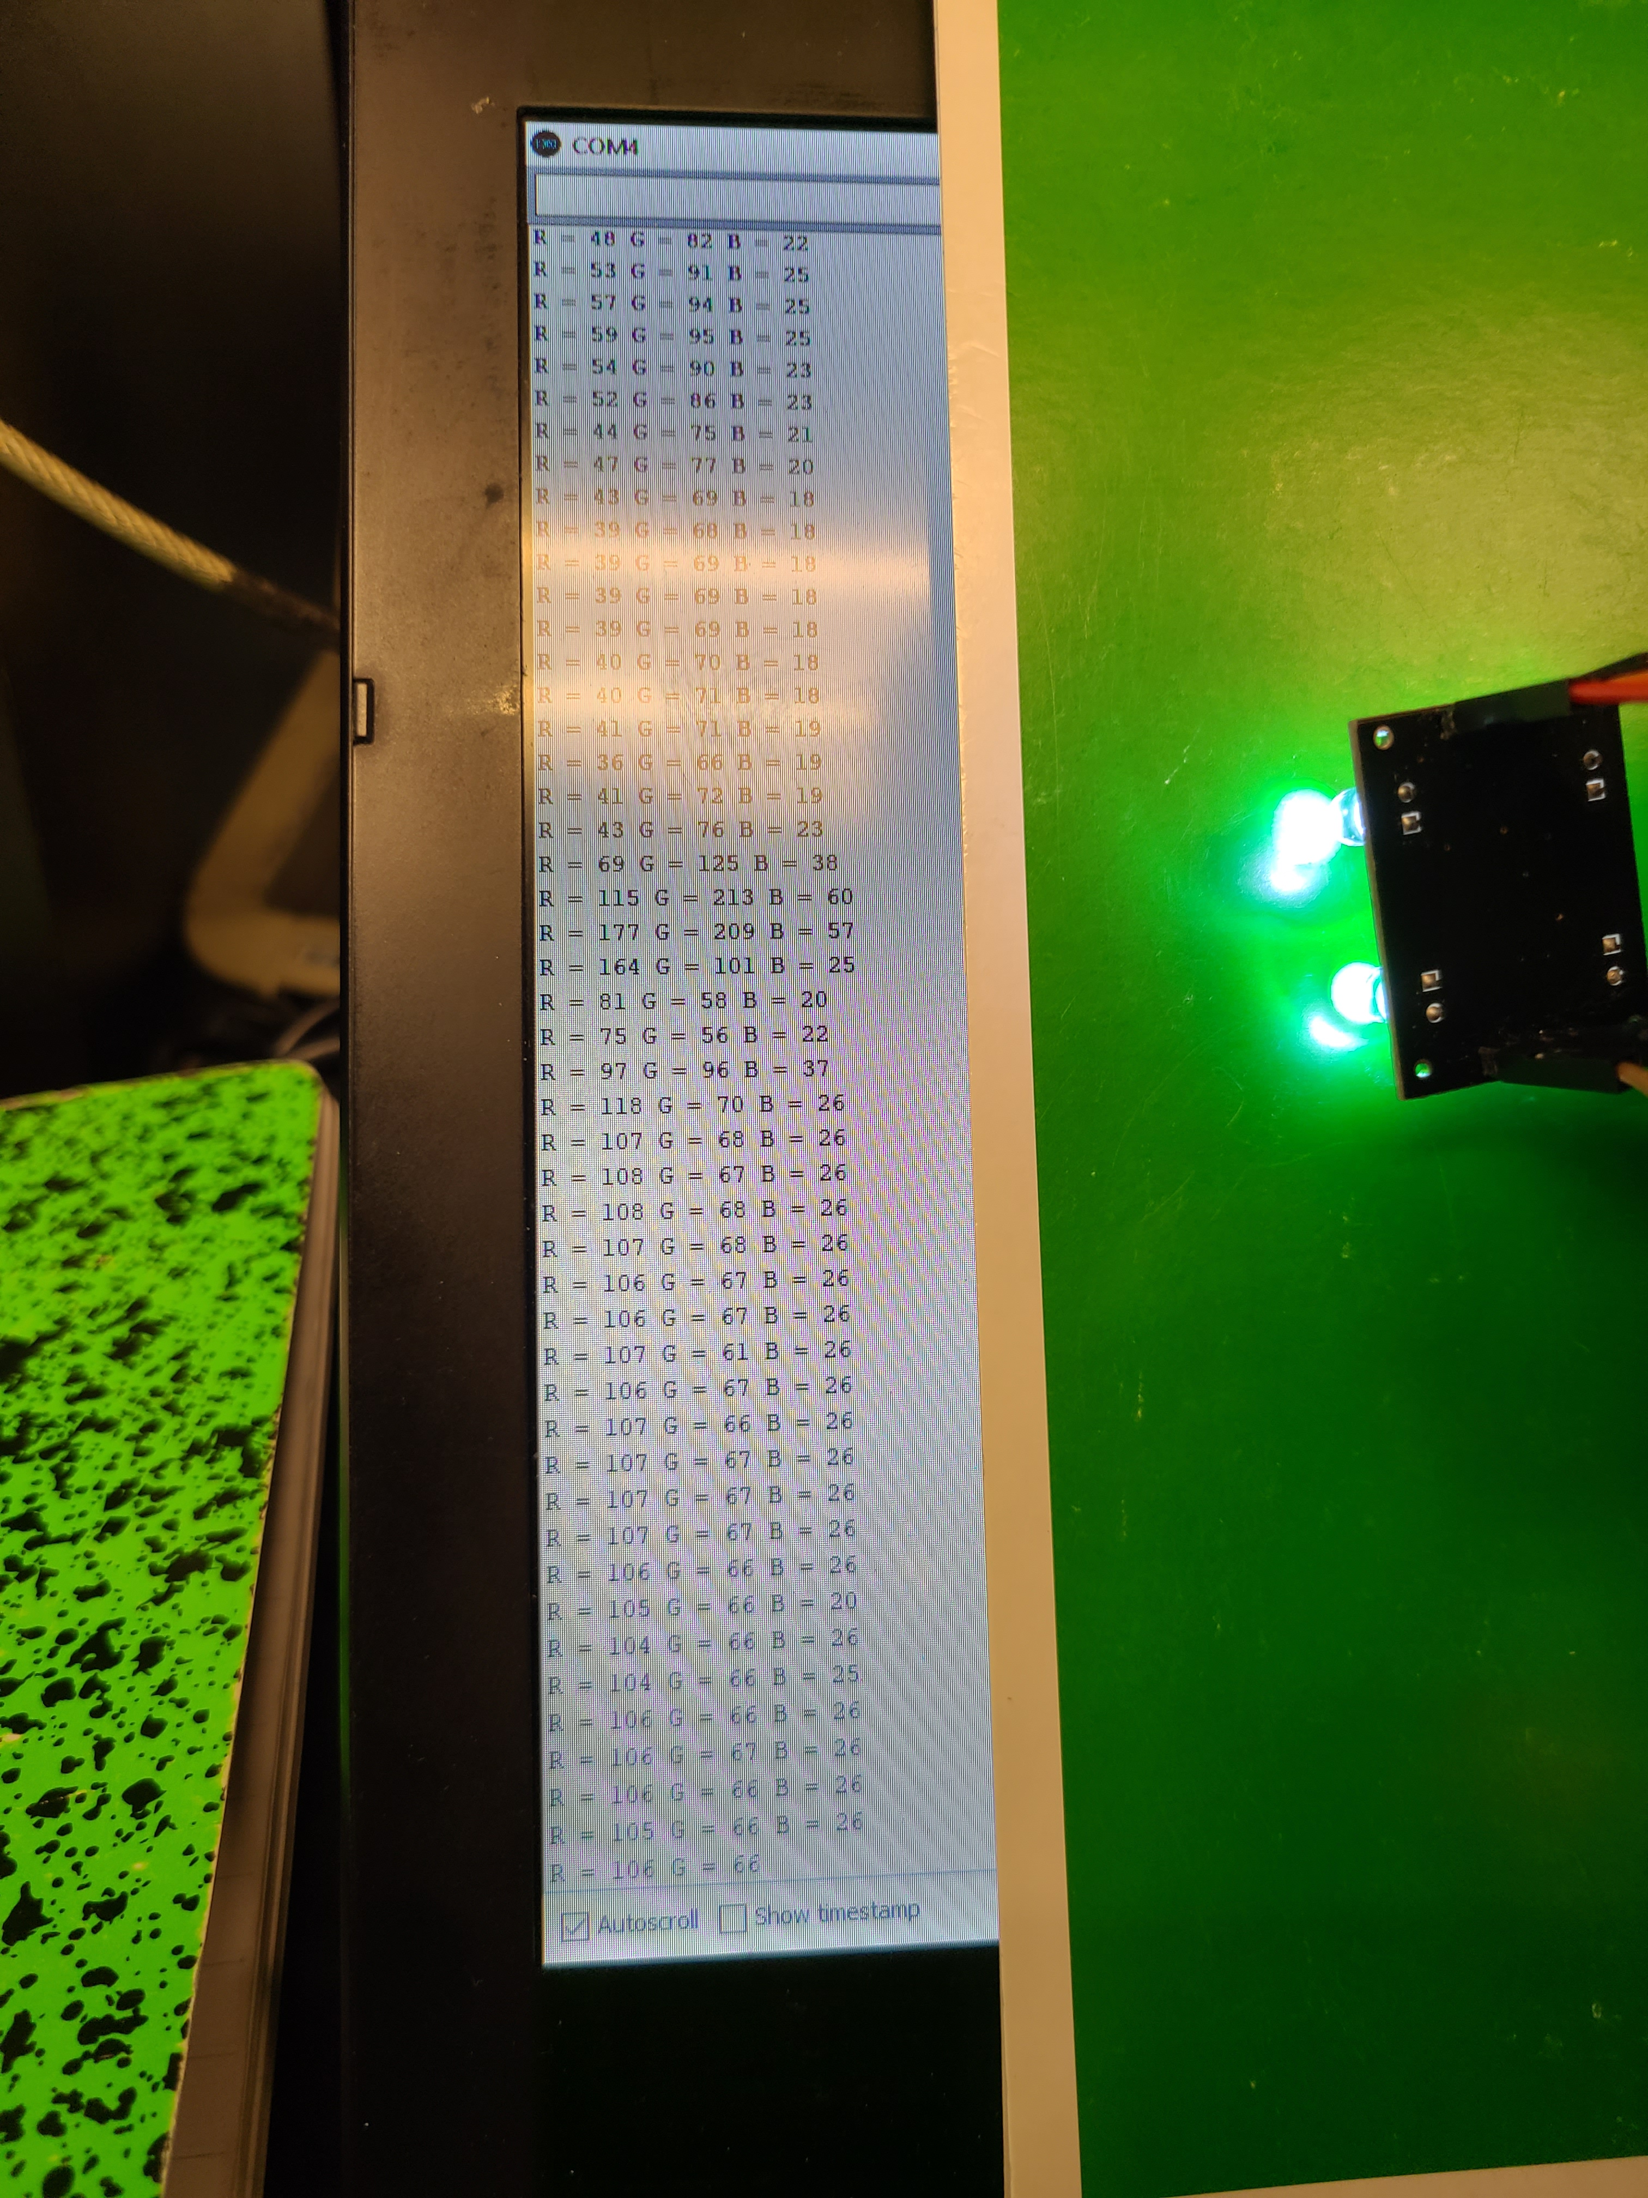
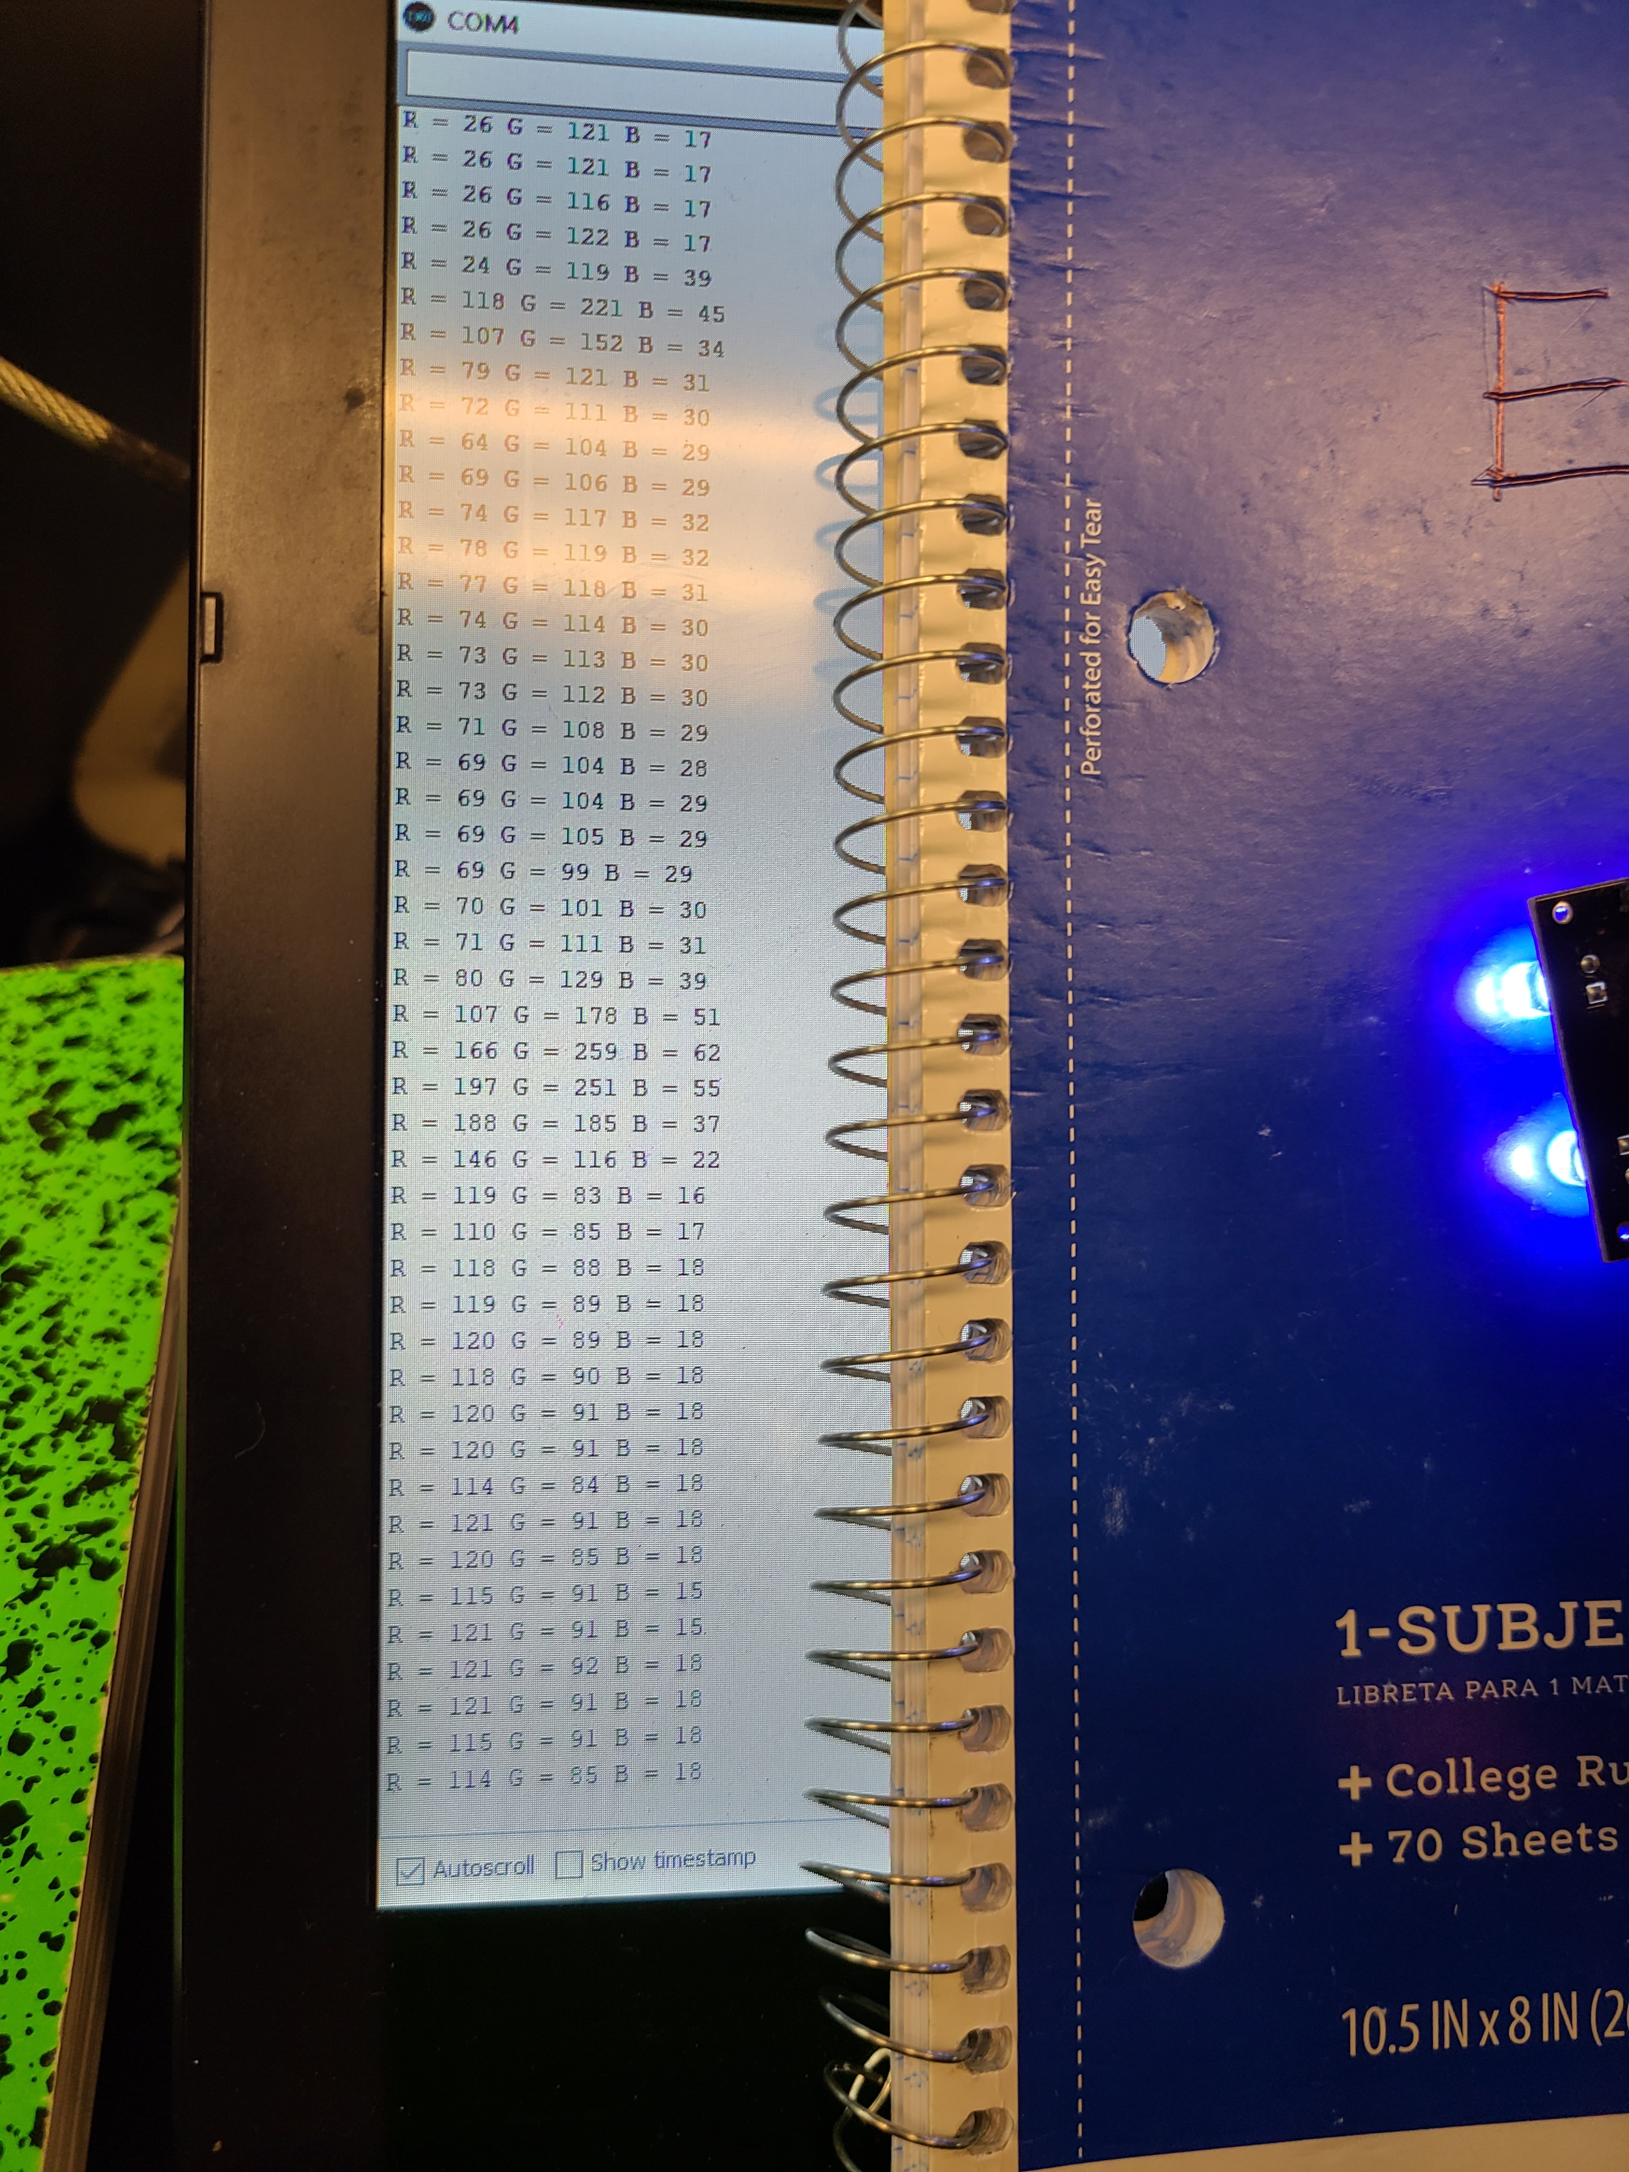
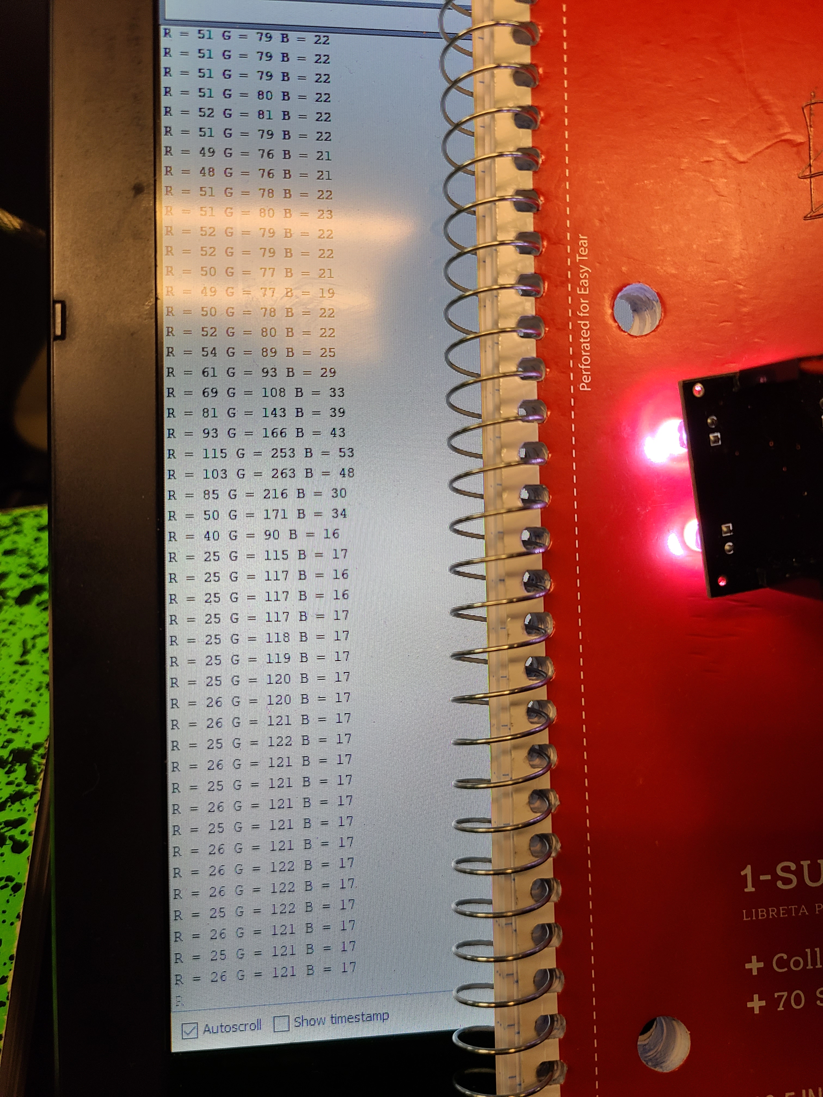
 | R | G | B
Green Folder | 100 | 66 | 26
Blue Folder | 120 | 92 | 20
Red Folder | 25 | 122 | 17
Ambient light | 50 | 80 | 20
Tested using Arduino Code from
[4] RandomNerdTutorials

Slide 15
Next Week’s Deliverables
Begin to research how to implement each part into the software
Begin to implement and test connections for the IPS and IR sensor onto our Rover
Brainstorm positions to hold the sensors from our rover
Design models in inventor

Slide 16
References
[1] IR Sensor (GP2Y0A60SZ0F) datasheet. https://www.pololu.com/file/0J812/gp2y0a60szxf_e.pdf.
[2] IPS Sensor (LJ18A3-8-Z/BX). http://files.microjpm.webnode.com/200003722-858c88684b/Condutive%20Proximity%20Switch%20Series.pdf
[3] Color Light-To-Frequency Converter (TCS3200) datasheet. https://www.mouser.com/catalog/specsheets/tcs3200-e11.pdf
[4] TCS3200 Tester Code. https://randomnerdtutorials.com/arduino-color-sensor-tcs230-tcs3200/

Slide 17

Questions

